Slide 1


Team Phantom
Design Presentation for:
Tag Cloud

Slide 2
Team Members
& Main Roles*
Tim Allman – Team Leader
Adam Stafford – Designer
Tuilla Chaves – Tester
Robert Cole has left to do the internship
Main Roles will be re-evaluated when all team members are present next week.
* Where possible all team members will share the workload equally, however members will be responsible for items falling under their main role. I.e. The chief coder is responsible for the overall code.

Slide 3
Design Document Summary
Tag Cloud is a simple standalone application which allows users to generate Tag Clouds from files on their computer and from text input through a form field.
Once the Tag Cloud is generated users can manipulate the contents, colour and layout of the cloud through a number of options.

Slide 4
The Application is being developed on the Unity platform using C#.
The finished article will be a executable file so it should be OS independent.
Assumptions and Dependencies:
Our end users will require only a passing competency with using computers, like being able to find a file on their machine.

Slide 5
Development Methods
We will use the Agile methodology to develop the application.
So the development process will be iterative in phases.
Phase 1 example: File Parsing System
Design phase 1, Code phase 1, Test phase 1, Integrate Phase 1 then Design phase 2 and so forth.

Slide 6
Notes on System Architecture
The Architecture of the system will closely follow the functional flow of a general Tag Cloud Generator.
Input source (txt or doc) goes to:
Parse File/Text goes to:
Generate Tag Cloud goes to:
Modify Tag Cloud goes to:
Export as Image or Share then exit or return to start.

Slide 7
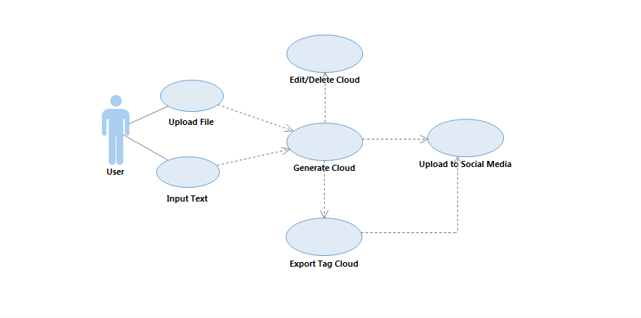
General Use Case for the System:

Slide 8
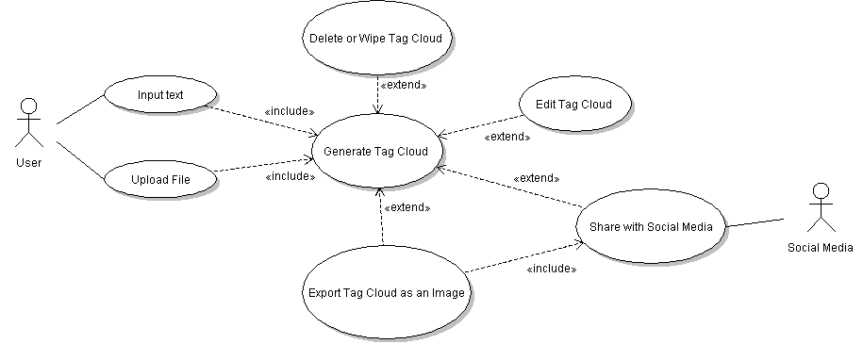
Expanded Use Case for the System:

Slide 9
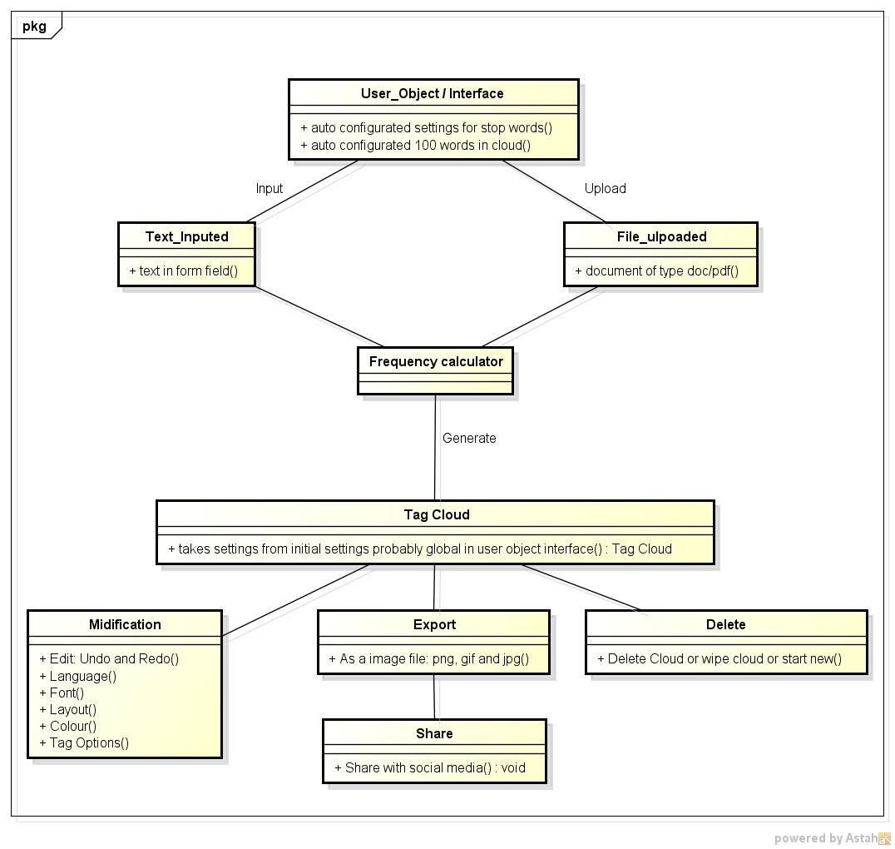

Slide 10
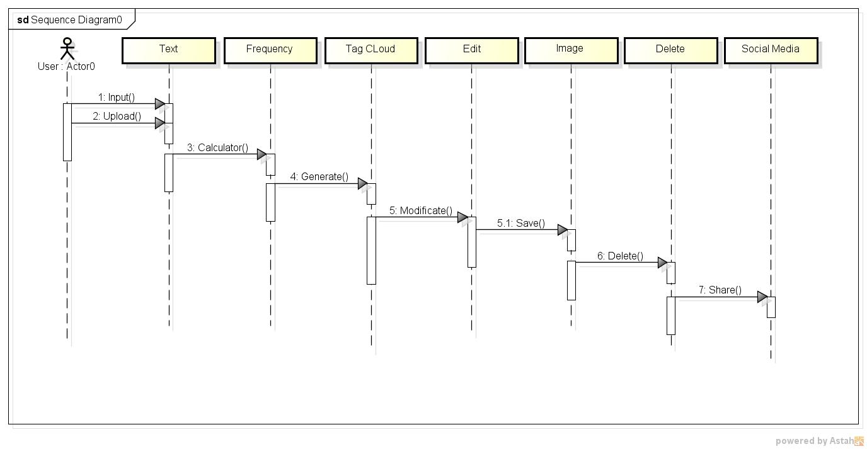
Sequence Diagram:

Slide 11
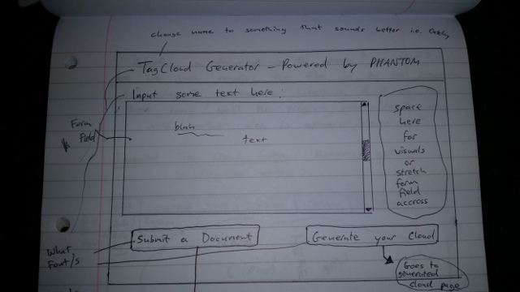
Paper Prototype GUI 1:

Slide 12
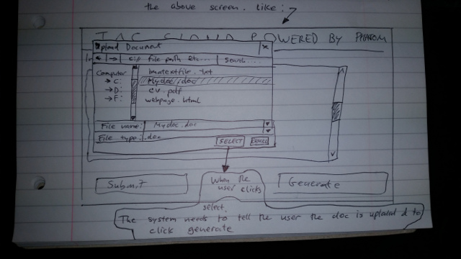
Paper Prototype GUI 2:

Slide 13
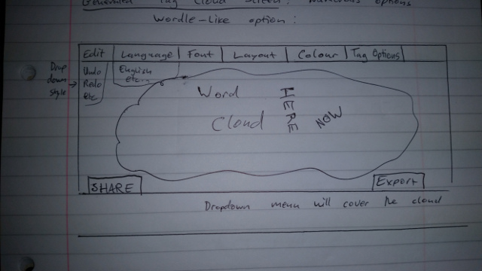
Paper Prototype GUI 3:

Slide 14
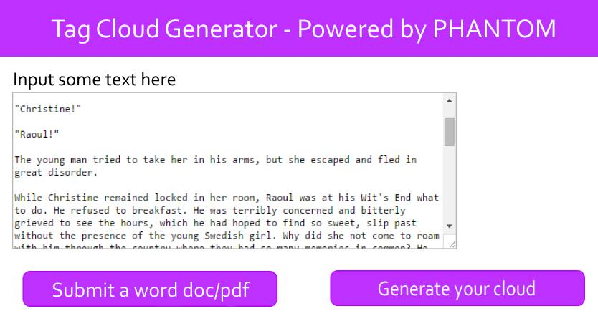
Previous Example Mock Up 1:

Slide 15
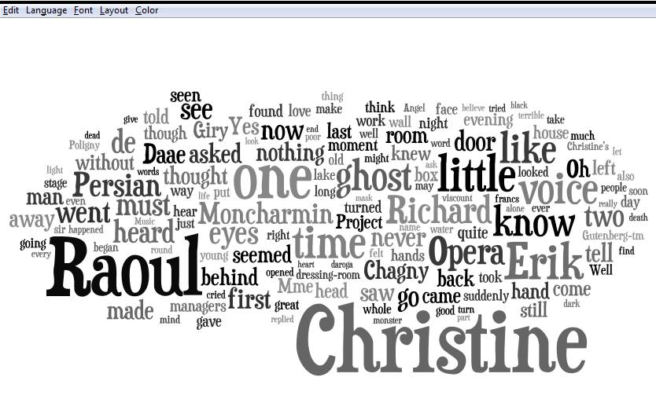
Previous Example Output Up 1:

Slide 16
Questions?

